Slide 1
Flynns Classification

Slide 2
Multiple Processor Organization
Single instruction, single data stream - SISD
Single instruction, multiple data stream - SIMD
Multiple instruction, single data stream - MISD
Multiple instruction, multiple data stream- MIMD

Slide 3
Single Instruction, Single Data Stream - SISD
Single processor
Single instruction stream
Data stored in single memory
Uni-processor

Slide 4
Single Instruction, Multiple Data Stream - SIMD
Single machine instruction
Controls simultaneous execution
Number of processing elements
Lockstep basis
Each processing element has associated data memory
Each instruction executed on different set of data by different processors
Vector and array processors

Slide 5
Multiple Instruction, Single Data Stream - MISD
Sequence of data
Transmitted to set of processors
Each processor executes different instruction sequence
Never been implemented

Slide 6
Multiple Instruction, Multiple Data Stream- MIMD
Set of processors
Simultaneously execute different instruction sequences
Different sets of data
SMPs, clusters and NUMA systems

Slide 7
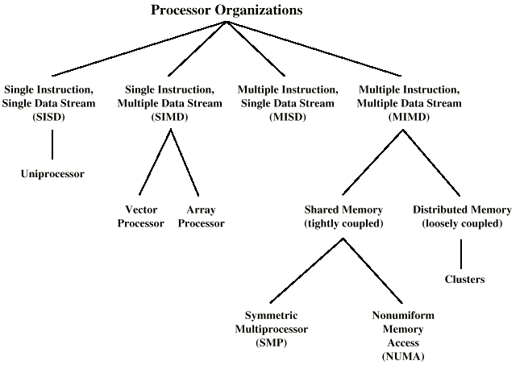
Taxonomy of Parallel Processor Architectures

Slide 8
MIMD - Overview
General purpose processors
Each can process all instructions necessary
Further classified by method of processor communication

Slide 9
Tightly Coupled - SMP
Processors share memory
Communicate via that shared memory
Symmetric Multiprocessor (SMP)
  Share single memory or pool
  Shared bus to access memory
  Memory access time to given area of memory is approximately the same for each processor

Slide 10
Tightly Coupled - NUMA
Nonuniform memory access
Access times to different regions of memory may differ

Slide 11
Loosely Coupled - Clusters
Collection of independent uniprocessors or SMPs
Interconnected to form a cluster
Communication via fixed path or network connections

Slide 12
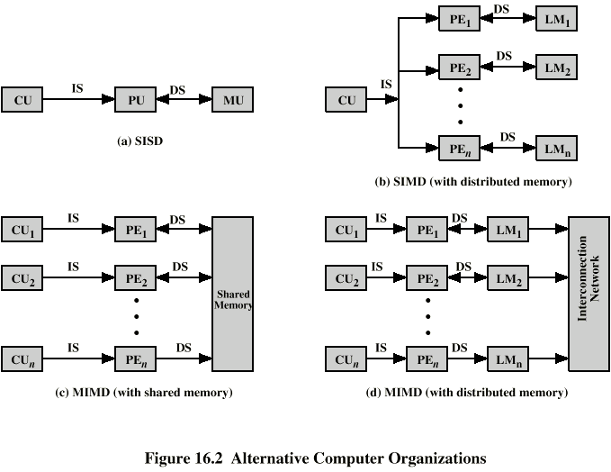
Parallel Organizations - SISD

Slide 13
Parallel Organizations - SIMD

Slide 14
Parallel Organizations - MIMD Shared Memory

Slide 15
Parallel Organizations - MIMD
Distributed Memory

